Slide 1
Karen-Savannah Check-In 28 July 2026
Goals of Meeting:
Checking in for confirmation of patterns of the data:
Geomorphic setting
Range of the data
Skewness or spread of the data
Slope
Organizing the different effects logically to have a coherent general linear mixed model
Status of data analysis of Thesis and USGS data

Slide 2
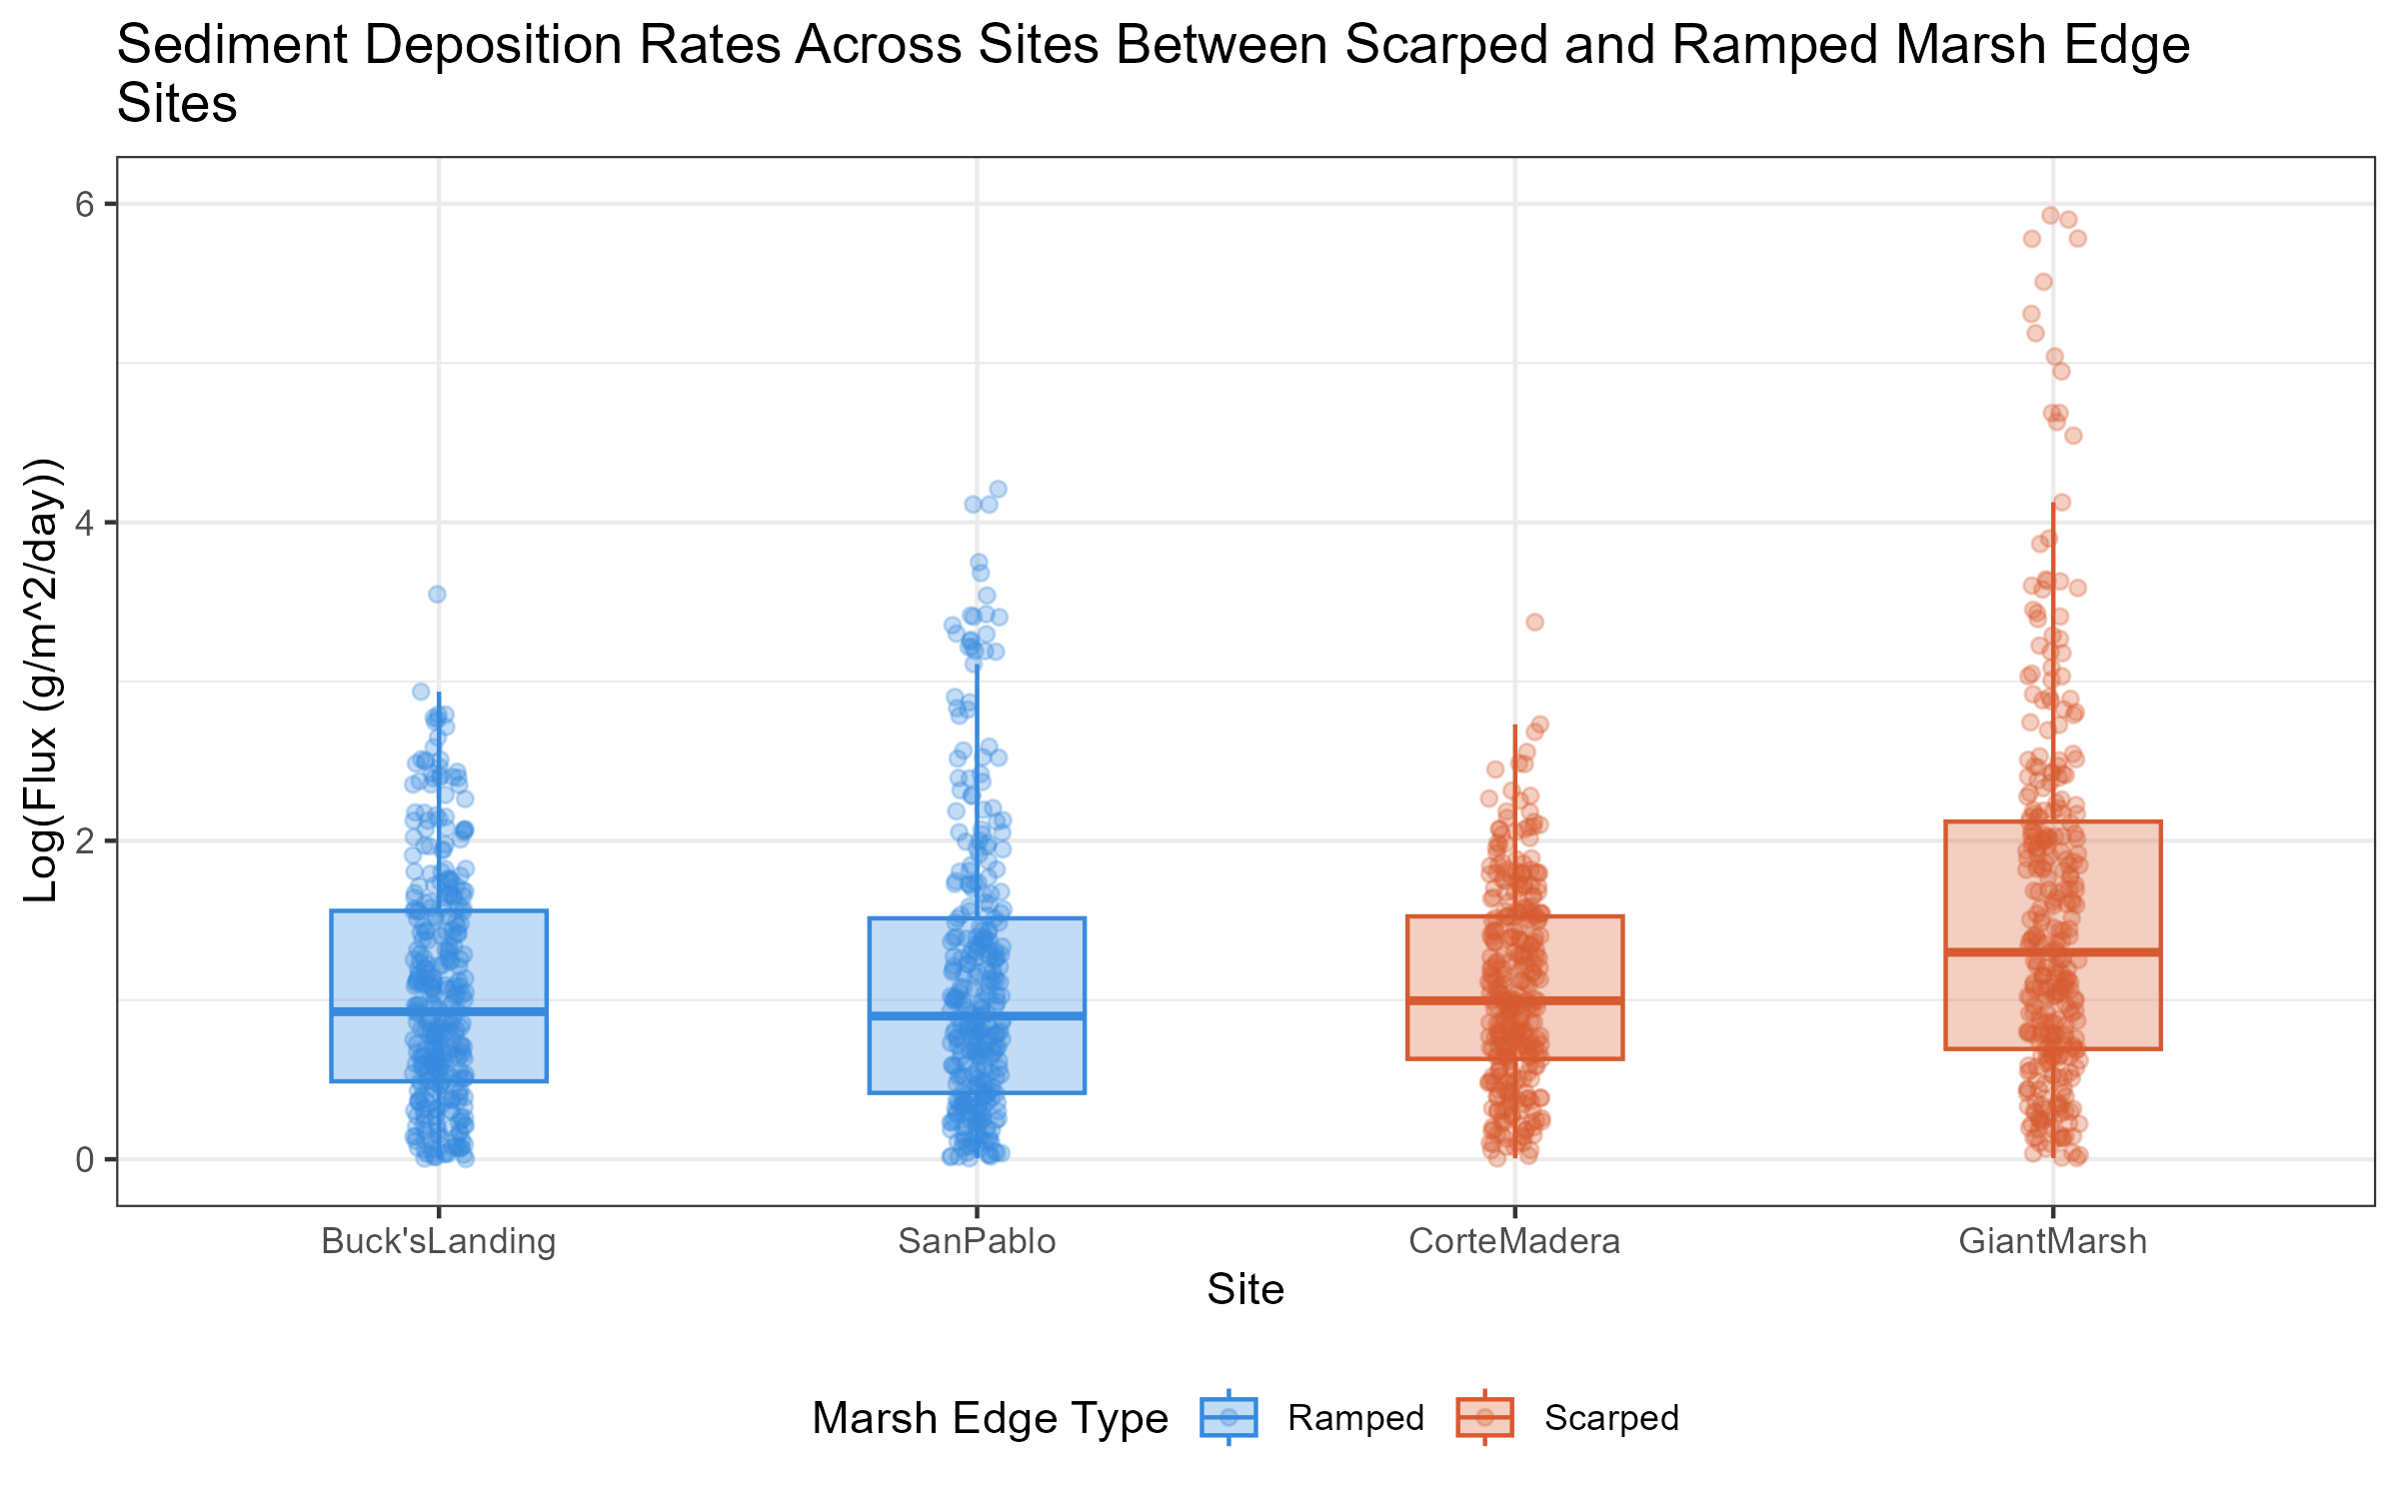

RQ #1: Does Marsh Edge Type Correlate with Rates of Sediment Deposition Site Level Comparison

Slide 3
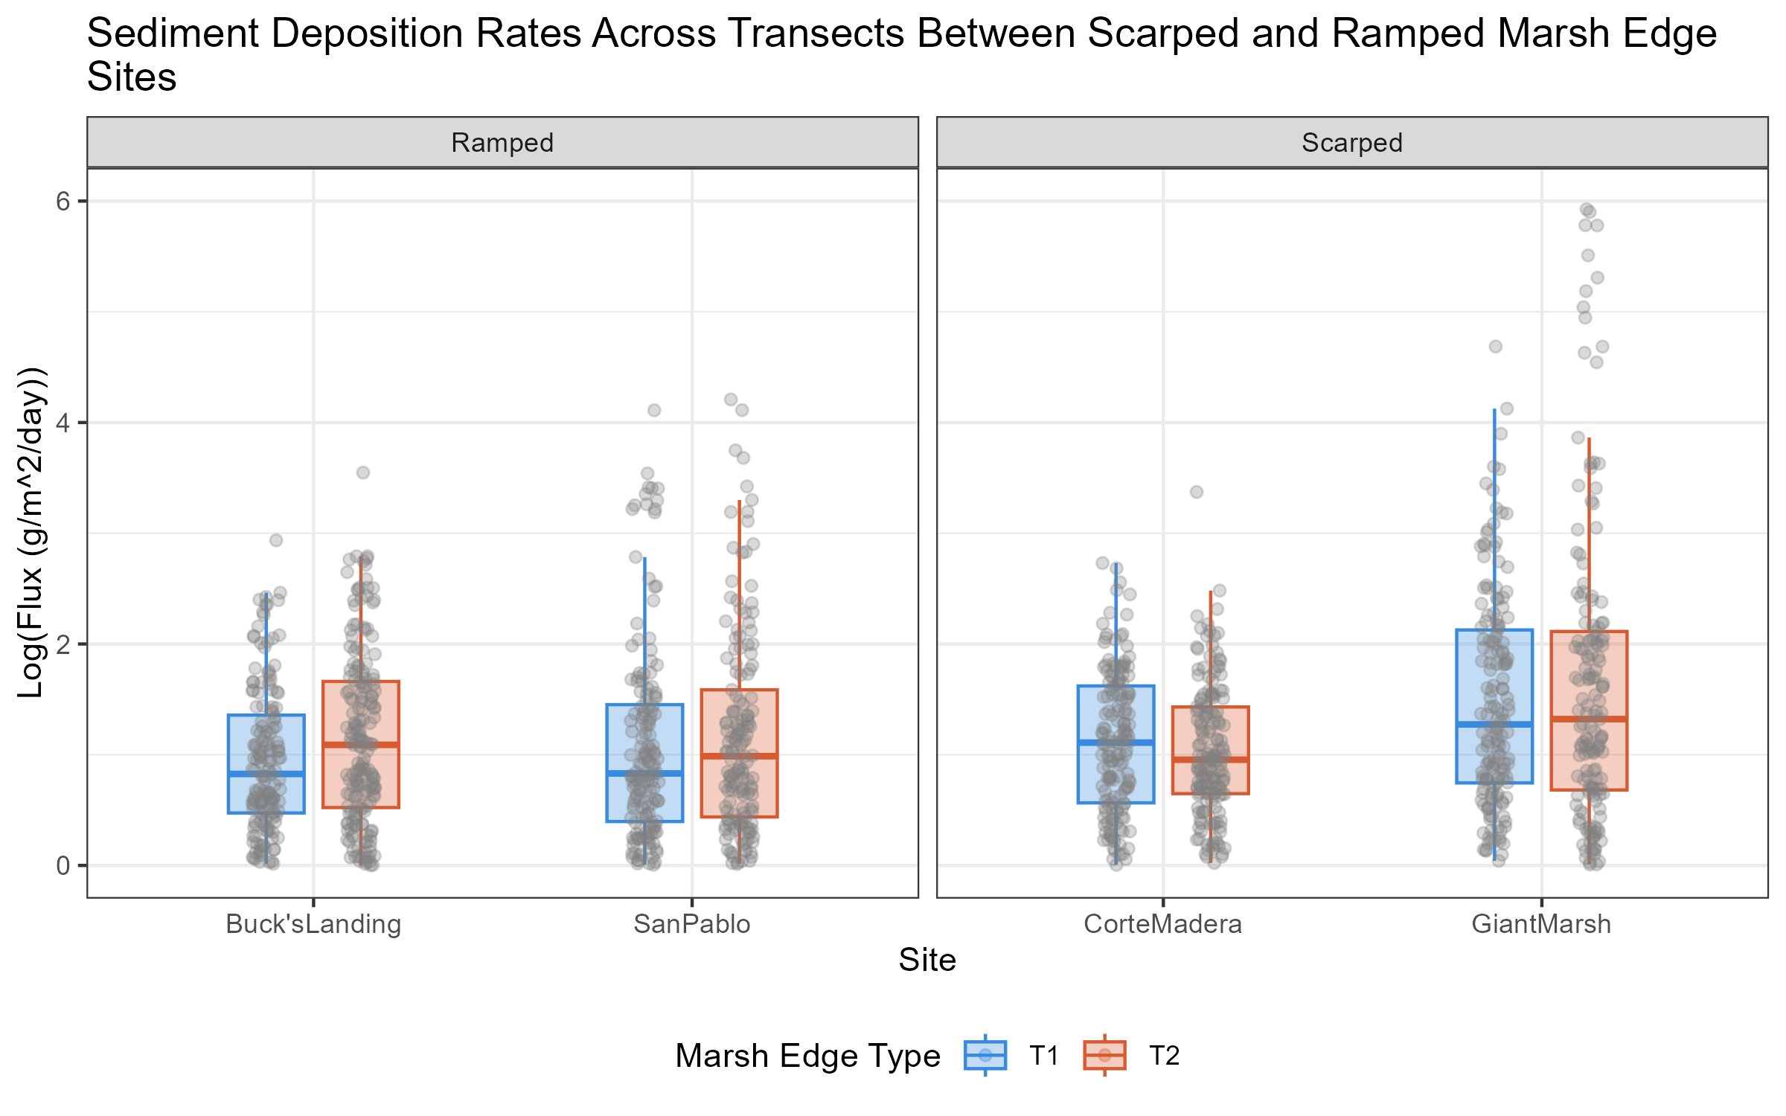
RQ #1: Transect Level Comparison of Sediment Deposition and Marsh Edge

Slide 4
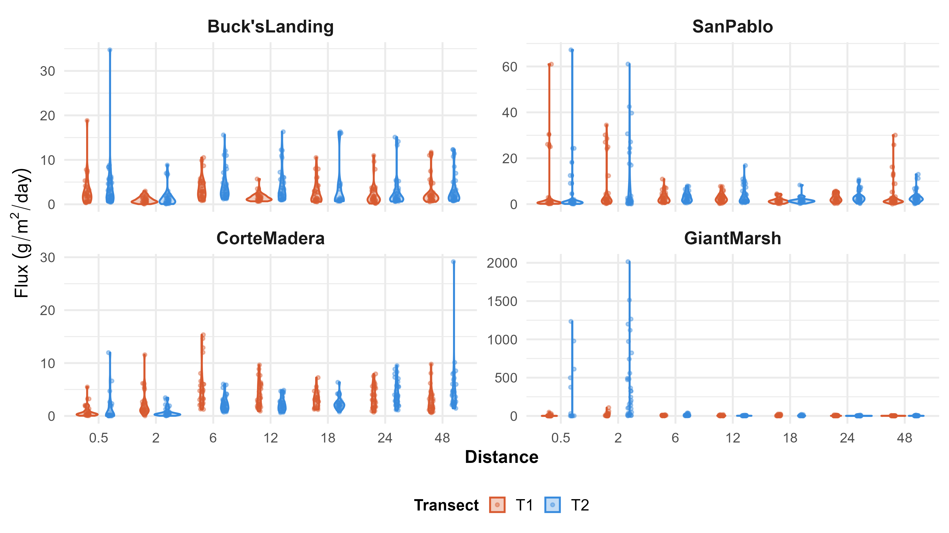
RQ #1: Sediment Deposition Over Distance Within Sites and Marsh Edge

Slide 5
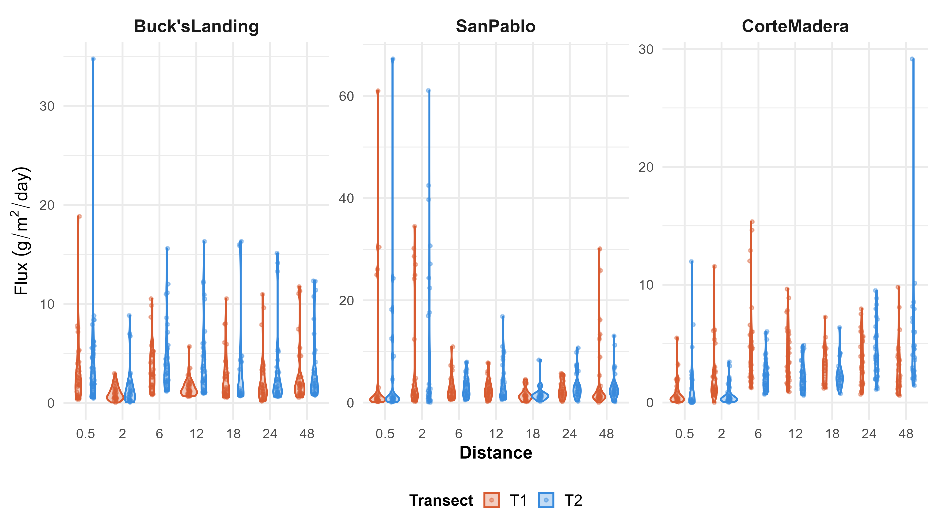
RQ #1: Sediment Deposition Over Distance Within Sites Excluding Giant Marsh

Slide 6
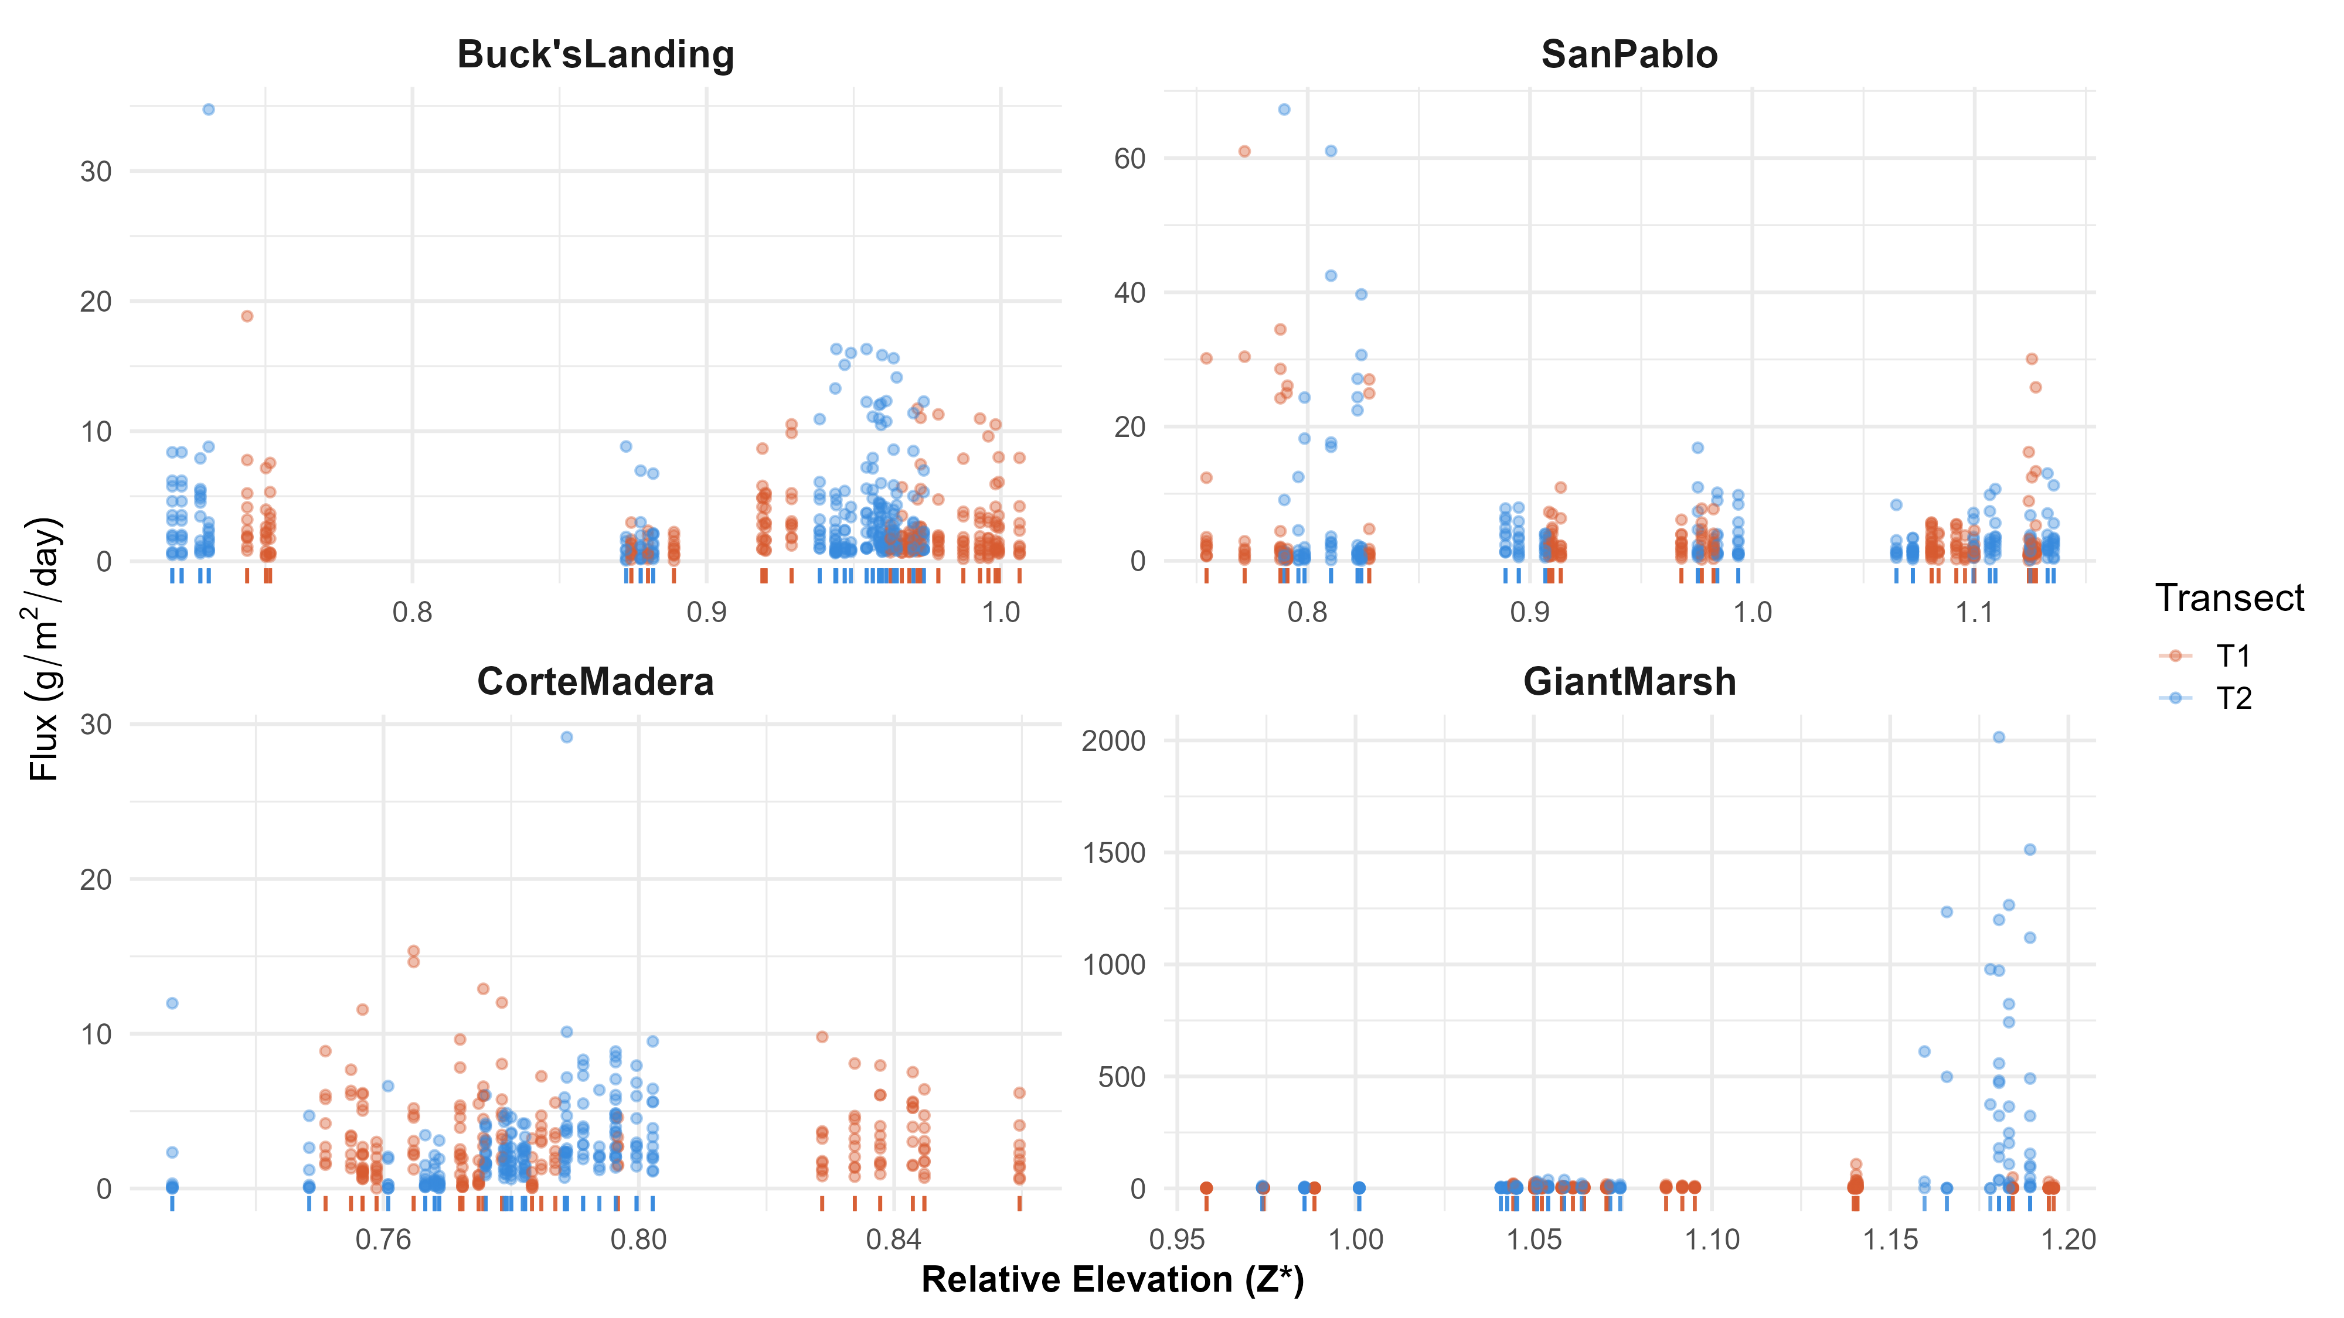
RQ #1: Sediment Deposition Over Calculated Z star Within Sites

Slide 7
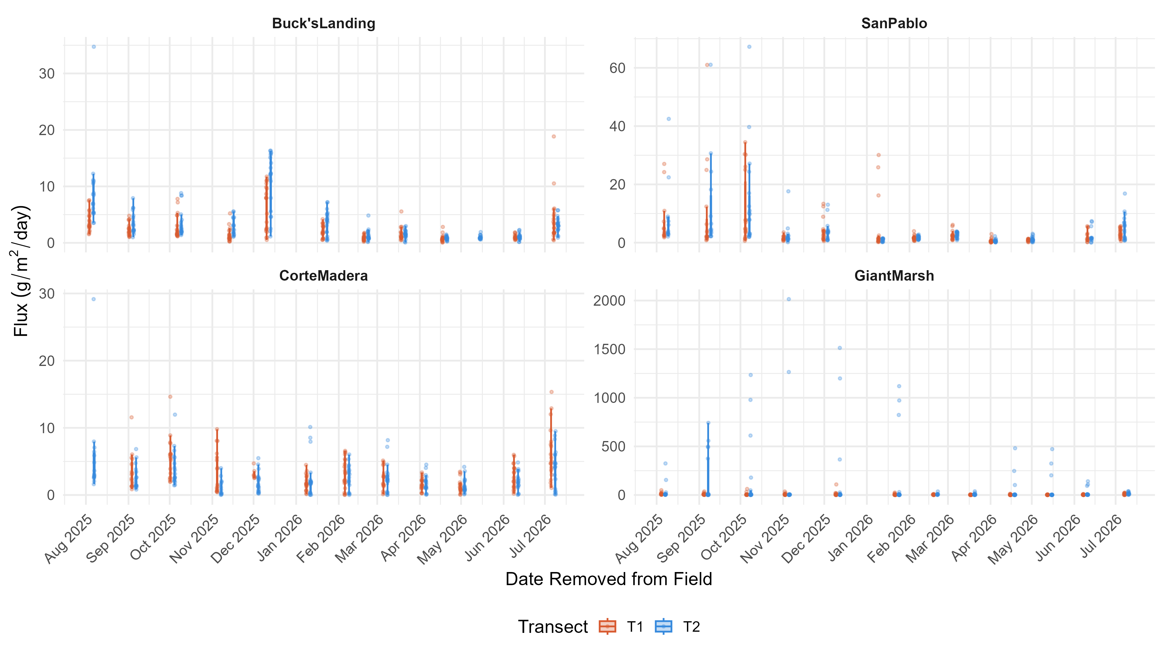
RQ #1: Deposition Across Time

Slide 8
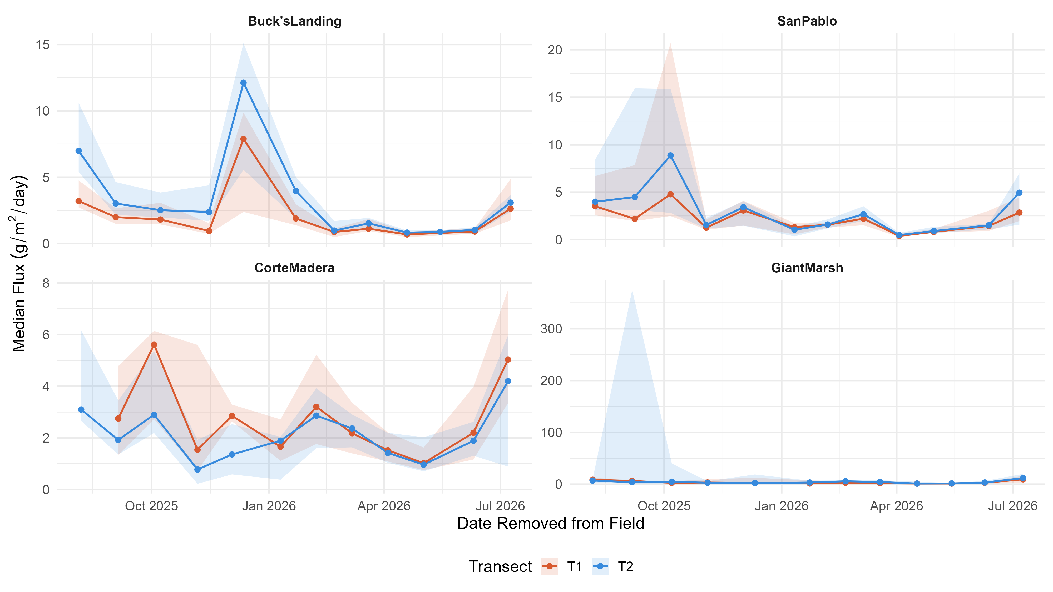
RQ #1: Deposition Across Time

Slide 9
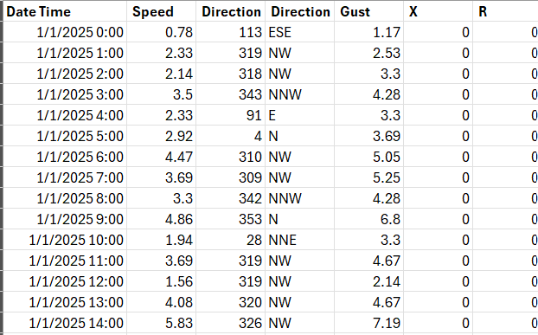
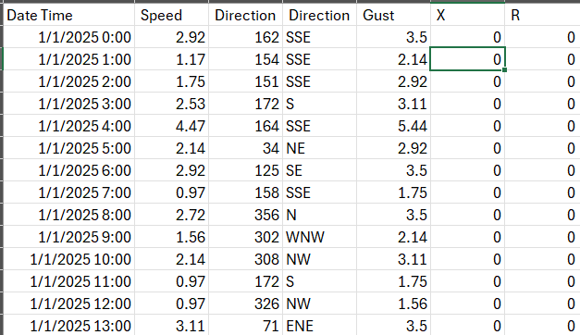
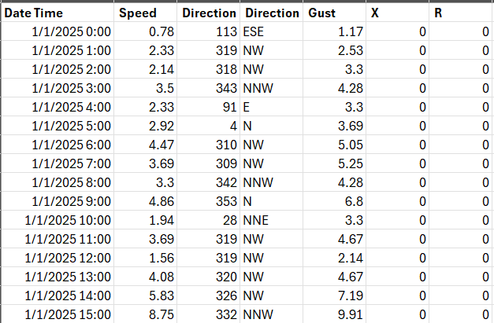
RQ #1: Additional variables to measure across marsh edge: wave characteristics!
Corte Madera, Buck’s Landing, Giant Marsh Sites
NOAA Station 9414863
San Pablo
NOAA Station 9415141

Slide 10
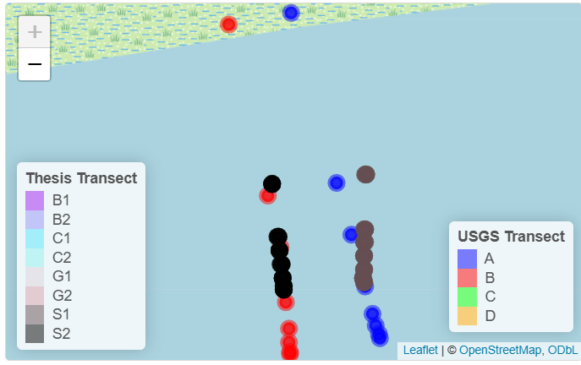
Research Question 2: Does sediment deposition rates change over time within a marsh edge?
San Pablo 2022/2023 and 2025/2026 Nuance of Placement
(USGS) 150 m
(USGS) 72 m
(Thesis) 48 m
(Thesis) 0.5 m

Slide 11
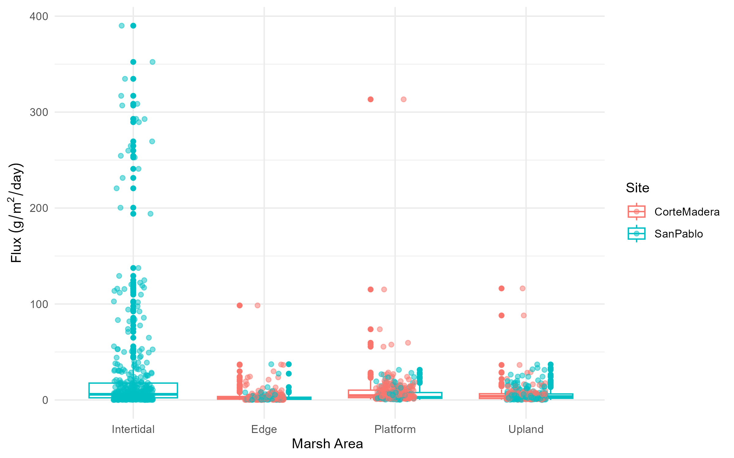
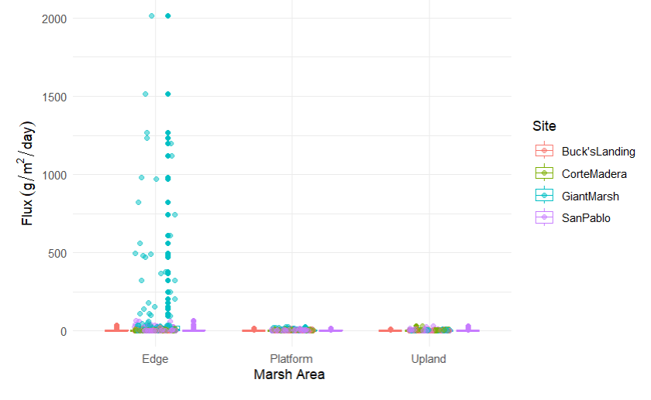
RQ# 2: Does sediment deposition rates change over time within a marsh edge?
2022-2023
2025-2026

Slide 12
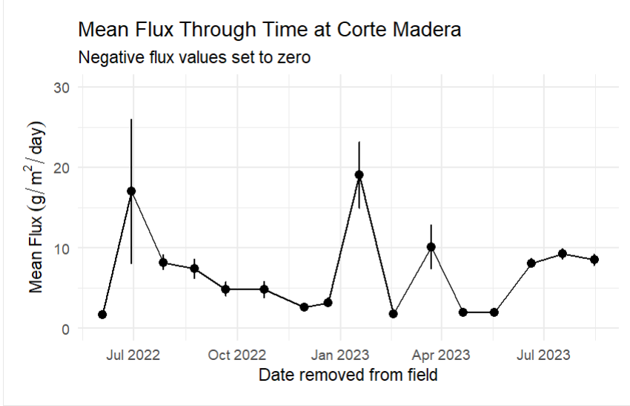
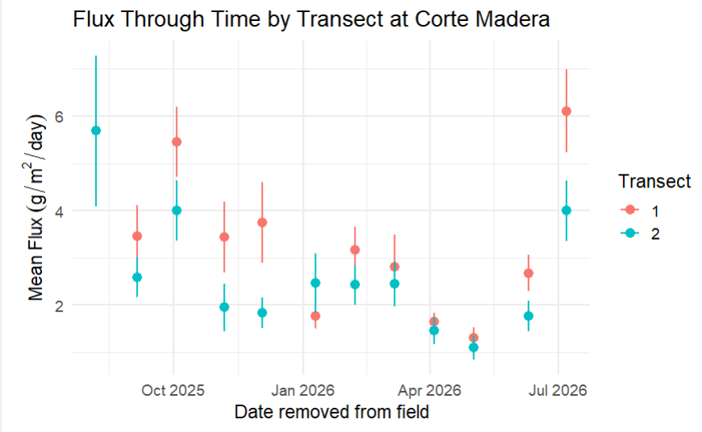
RQ # 2: Corte Madera
2022-2023
2025-2026

Slide 13
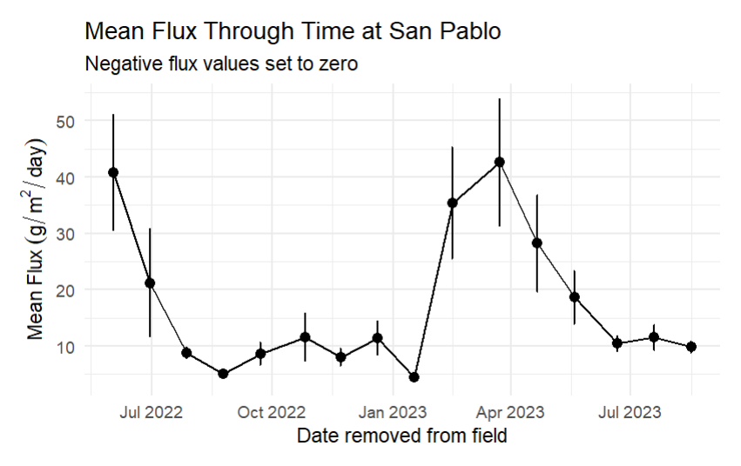
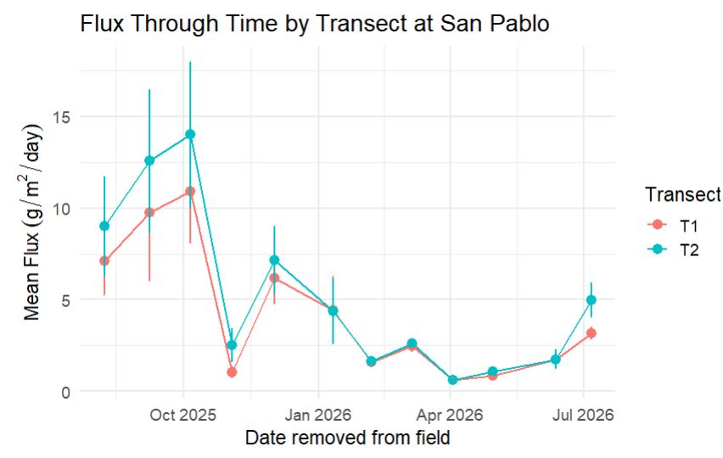
RQ # 2: San Pablo*
2022-2023
2025-2026
*2022-2023 not yet filtered from the different intertidal and distance data

Slide 14
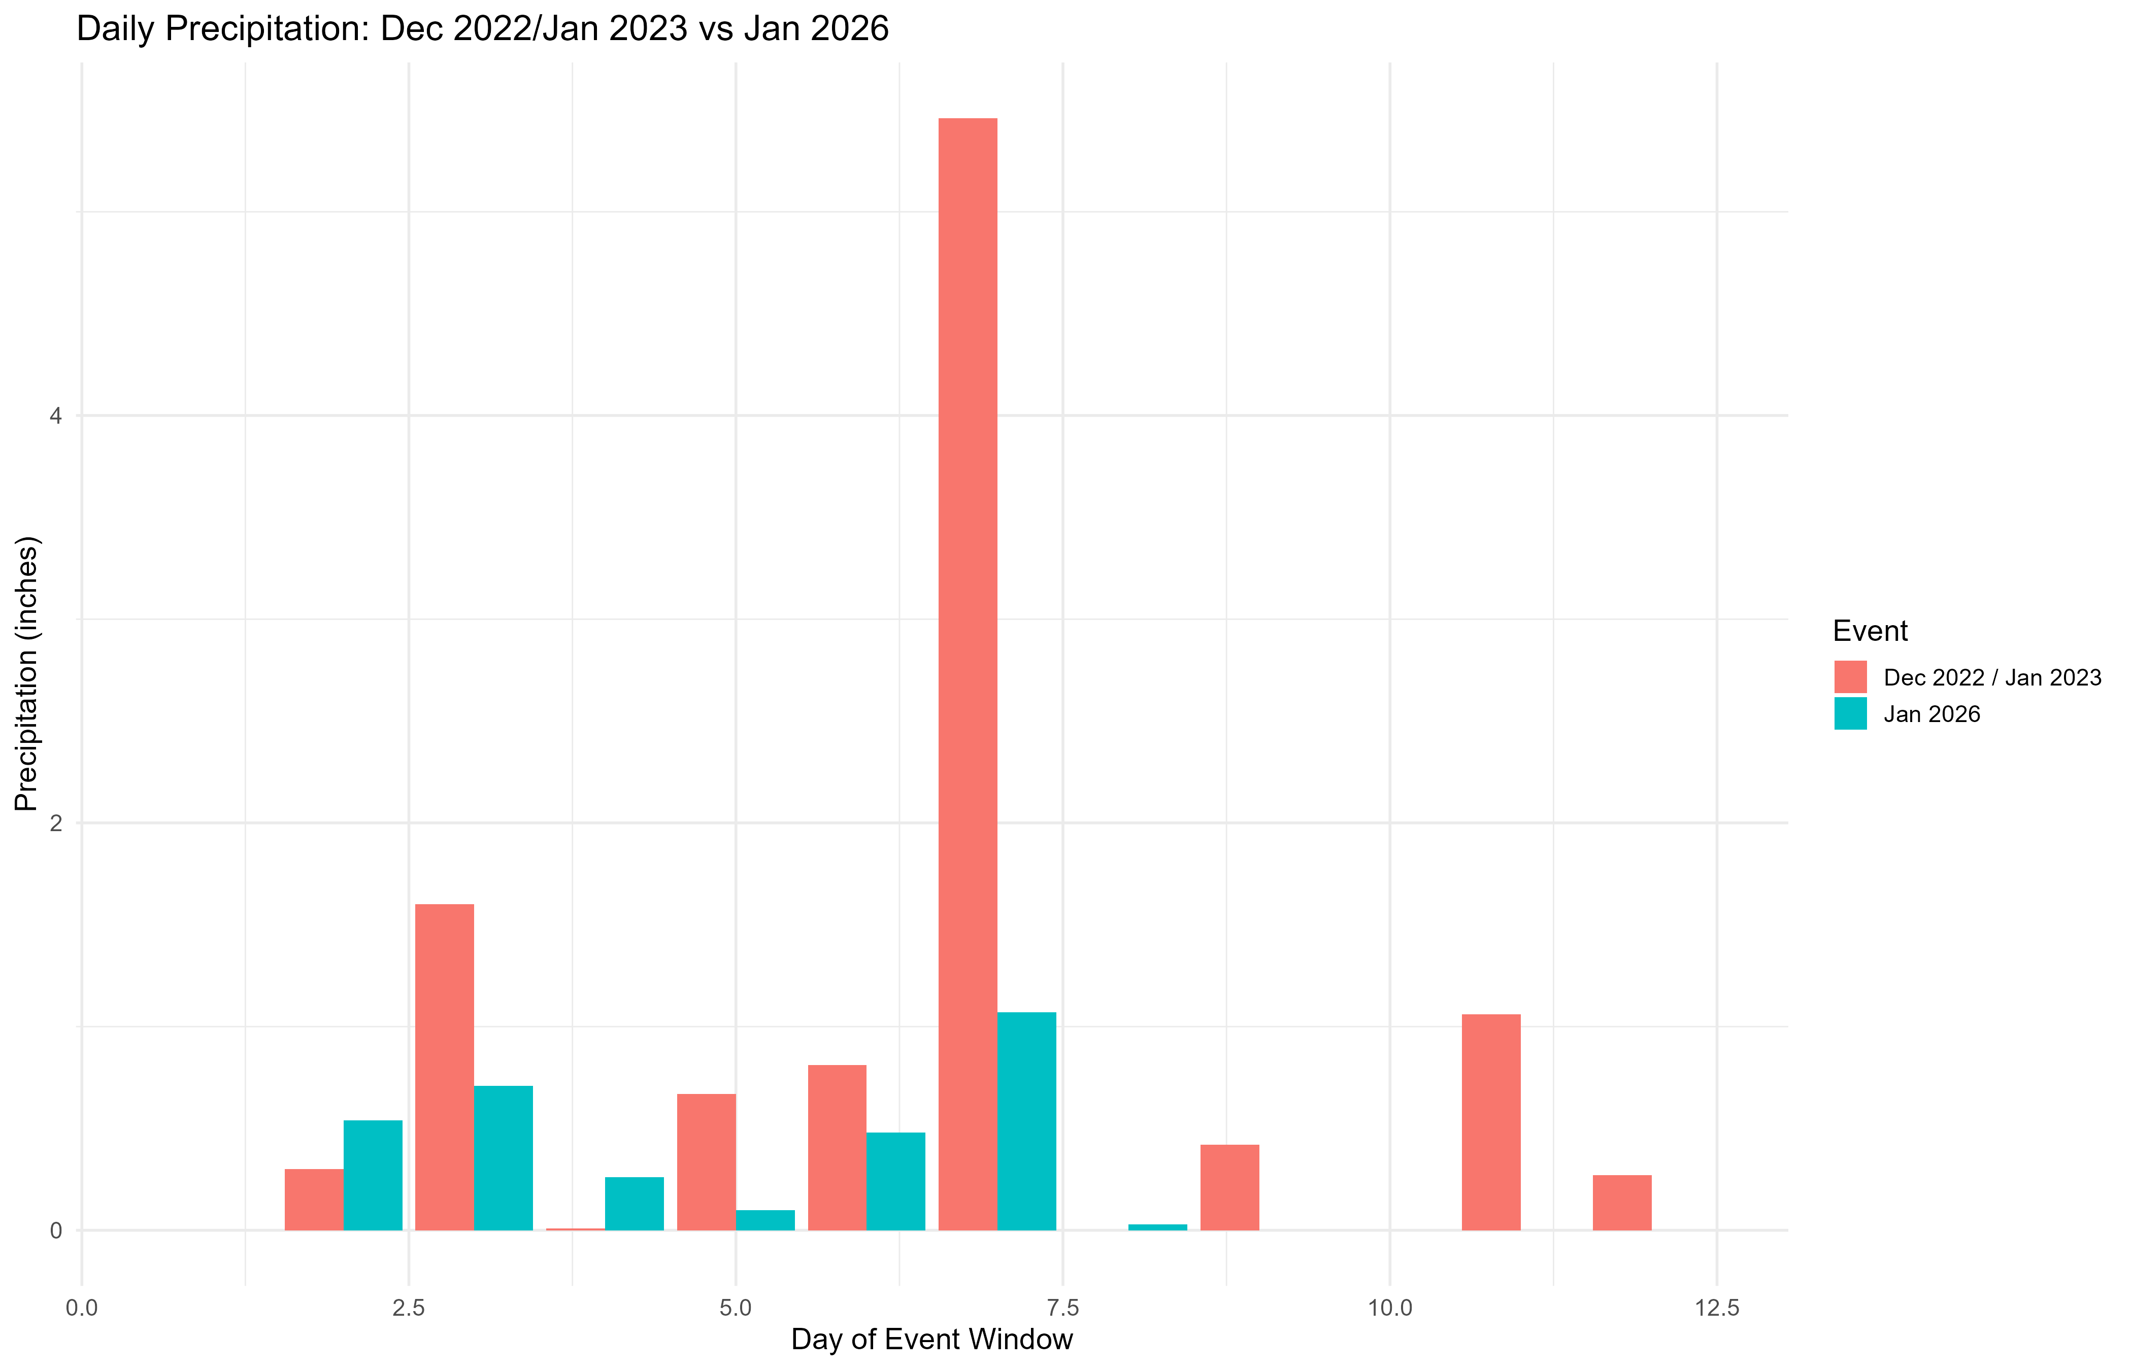
RQ # 2: Precipitation and Storm Events!

Slide 15
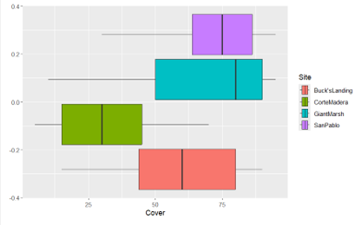
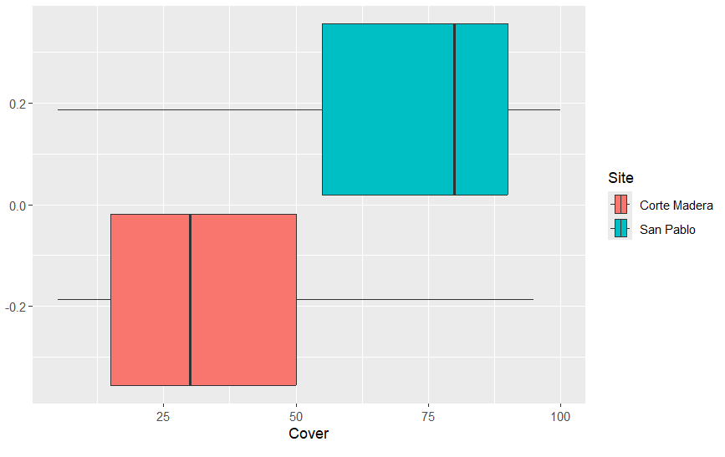
Research Question 3: Does intra-site differences account for differences of sediment deposition rate, regardless of marsh edge type?
Comparing Vegetation Canopy Across Site and Time
2022-2023
2025-2026

Slide 16
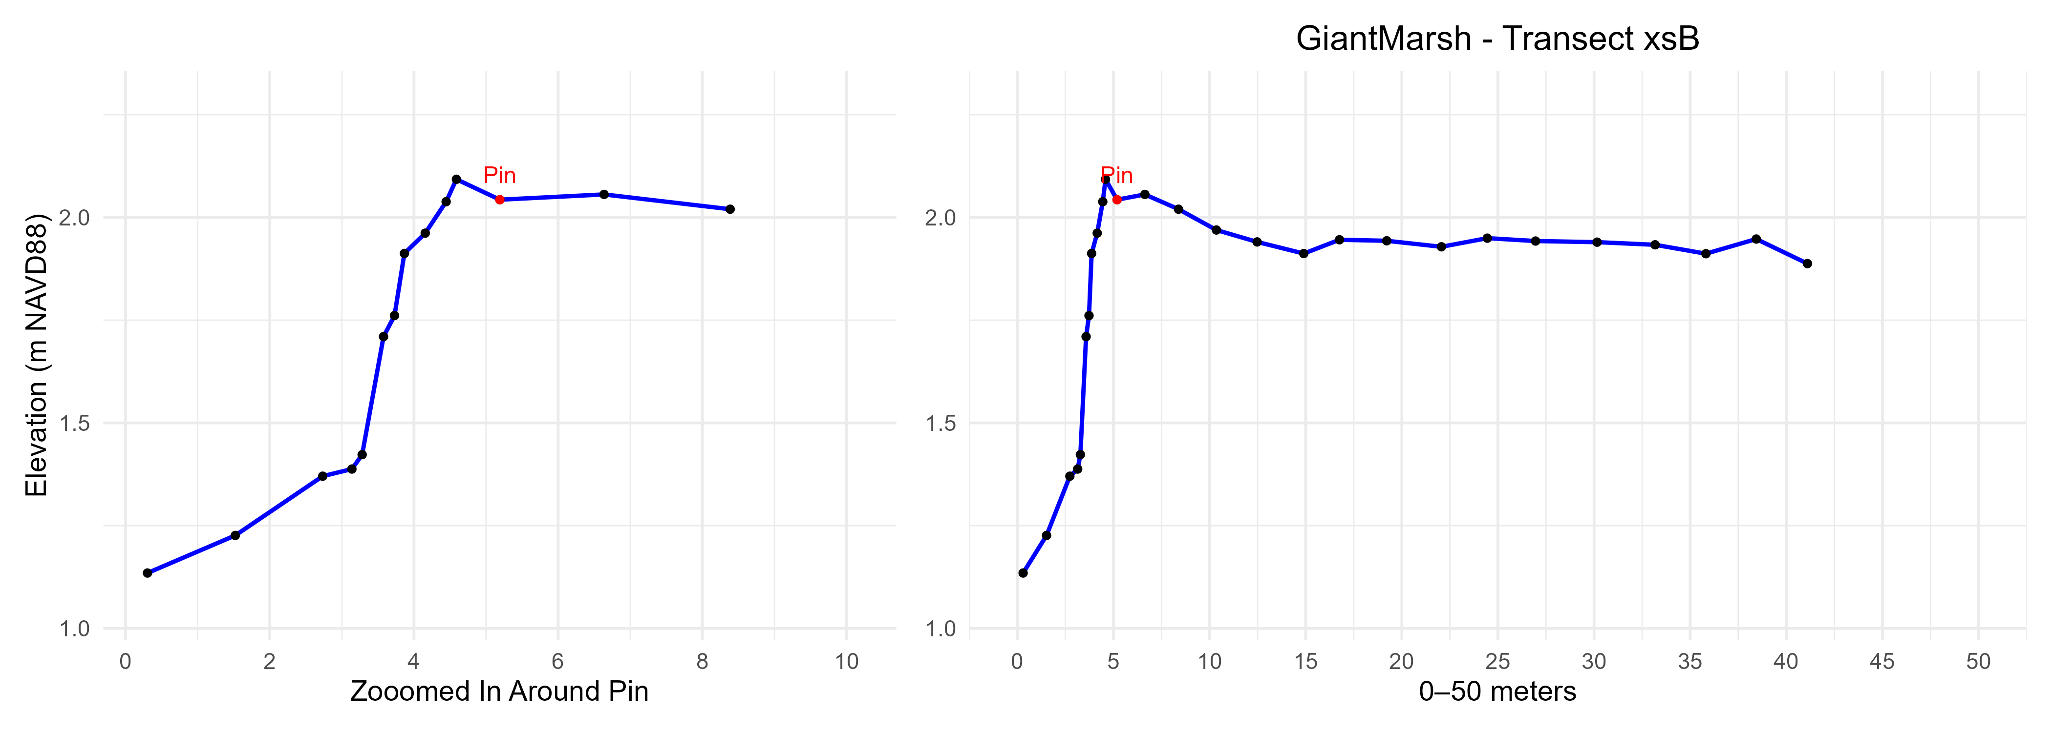
RQ# 3: Horizontal elevation profiles before and after the study per transect
June 2025…will have updated profiles for July 2026

